Slide 1
OCR
KT VIMAL
MES20MCA-2024
PRODUCT OWNER: MR SYED FEROZE AHAMED M

Slide 2
TABLE OF CONTENTS
Introduction
Modules
Data Flow Diagram
Table Design
Developing Environment
Product Backlog
User Stories
Project Plan
Sprint Plans
Sprint Actual

Slide 3
INTRODUCTION
OCR stands for Optical Character Recognition. It is a technology that recognizes text within a digital image. It is commonly used to recognize text in scanned documents and images. OCR software is able to go through documents and make the contents machine-readable. So that they can be worked with in an electronic format. It can be used for many different documents and allows many tasks to be automated.
The aim of this project is make text data to digital data. Thus the data can be documented. So that the retrieved data can be used in several places
This application uses OCR in a way so that documentation can be done in a simple way. When we want to document something we type the content into the document using a keyboard which will take a lot of time. So to reduce the time needed and to make the documentation easy we use the OCR.
The text-to-speech and speech-to-text are also used so that the details we speak are turned to digital data and the digitalized data is read to the user. We can select the documents which are read to the user using text-to-speech. The file is saved in docx format in the mobile device.

Slide 4
MODULES
USER
Registration
Login
Scan files
Text to Speech
Speech to Text
Save files
View files
View user history

Slide 5

DATA FLOW DIAGRAM
LEVEL 0

Slide 6
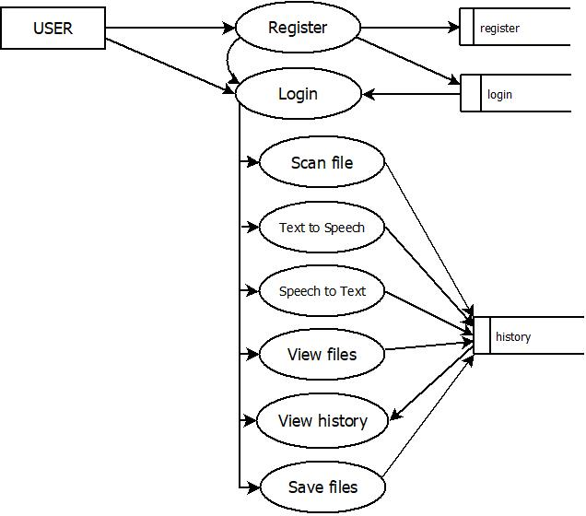
LEVEL 1.1

Slide 7
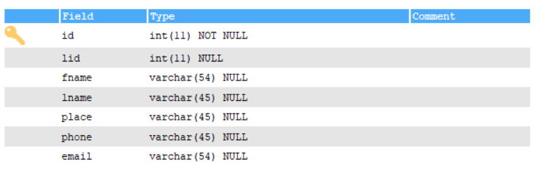
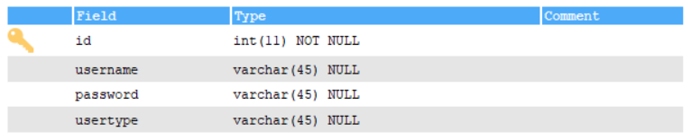
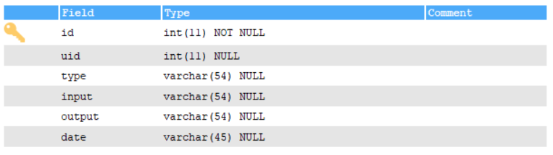
TABLE DESIGN
user
login
history

Slide 8
DEVELOPING ENVIRONMENT
Hardware Requirements
Processor - Intel x86
Speed - 1.1 GHz
RAM - 4 GB (min)
Hard Disk - 50 GB
Software Requirements
Operating System - Windows 7 or Above ,Android
Frontend - Android
Backend – Python ,MySQL
Platform used - PyCharm, Android Studio ,SQLyog
Web Browser - Google Chrome, Fire fox, Microsoft Edge
Frame work - Flask

Slide 9
PRODUCT BACKLOG
User Story ID | Priority <High/Medium/Low> | Size (Hours) | Sprint <#> | Status <Planned/In progress/Completed> | Release Date | Release Goal
1 | Medium | 2 | 1 | Completed | 08/01/2022 | Table design
2 | High | 3 |  | Completed | 08/01/2022 | Form design
3 | High | 5 |  | Completed | 08/01/2022 | Basic coding
4 | High | 5 | 2 | Planned |  | Scan files
5 | Medium | 5 |  | Planned |  | Text –to-speech
6 | High | 5 | 3 | Planned |  | Speech-to-text
7 | high | 5 |  | Planned |  | Save files
8 | Medium | 5 | 4 | Planned |  | Testing data
9 | High | 5 |  | Planned |  | Output generation

Slide 10
USER STORIES
UserStoryID | As a <type of user> | I want to | So that I can
1 | User | login | login successful with correct username and password
2 | User | Registration | user's can register with this app
3 | User | Scan files | Images with text are taken and scanned using OCR
4 | User | Text to Speech | The text is converted to speech
5 | User | Speech to Text | The words the user says are converted to text
6 | User | View files | Files are viewed from the phone storage
7 | User | View history | View history of user in app
8 | User | Save files | Save files in docx in storage

Slide 11
PROJECT PLAN
User Story ID | Task Name | Start Date | End Date | Days | Status
1 | Sprint 1 | 26/12/2021 | 28/12/2021 | 2 | Completed
2 |  | 29/12/2021 | 31/12/2021 | 3 | Completed
3 |  | 03/12/2021 | 08/01/2022 | 5 | Completed
4 | Sprint 2 | 09/01/2022 | 16/01/2022 | 8 | Planned
5 |  | 18/01/2022 | 22/01/2022 | 5 | Planned
6 | Sprint 3 | 23/01/2022 | 27/01/2022 | 5 | Planned
7 |  | 30/01/2022 | 05/02/2022 | 7 | Planned
8 | Sprint 4 | 06/02/2022 | 10/02/2022 | 5 | Planned
9 |  | 16/02/2022 | 19/02/2022 | 4 | Planned

Slide 12
SPRINT BACKLOG PLAN
Backlog Item | Status & completion date | Original estimate in hours | Day1 | Day2 | Day3 | Day4 | Day5 | Day6 | Day7 | Day8 | Day9 | Day10 | Day11 | Day12 | Day13 | Day14
User story #1,#2,#3 |  | hrs | hrs | hrs | hrs | hrs | hrs | hrs | hrs | hrs | hrs | hrs | hrs | hrs | hrs | hrs
Table design | 28/12/2021 | 2 | 1 | 1 | 0 | 0 | 0 | 0 | 0 | 0 | 0 | 0 | 0 | 0 | 0 | 0
Form design | 31/12/2021 | 3 | 0 | 0 | 0 | 1 | 1 | 1 | 0 | 0 | 0 | 0 | 0 | 0 | 0 | 0
Coding | 08/01/2021 | 5 | 0 | 0 | 0 | 0 | 0 | 0 | 0 | 0 | 0 | 1 | 1 | 1 | 1 | 1
User story #4,#5,#6,#7,#8
Scan files | 16/01/2022 | 5 | 1 | 1 | 0 | 1 | 0 | 1 | 0 | 1 | 0 | 0 | 0 | 0 | 0 | 0
Text–to-speech | 22/01/2022 | 5 | 0 | 0 | 0 | 0 | 0 | 0 | 0 | 0 | 0 | 1 | 1 | 1 | 1 | 1
Speech-to-text | 27/01/2022 | 5 | 1 | 1 | 1 | 1 | 1 | 0 | 0 | 0 | 0 | 0 | 0 | 0 | 0 | 0
Save files | 05/02/2022 | 5 | 0 | 0 | 0 | 0 | 0 | 0 | 0 | 1 | 0 | 1 | 1 | 1 | 0 | 1
Testing data | 10/02/2022 | 5 | 1 | 1 | 1 | 1 | 1 | 0 | 0 | 0 | 0 | 0 | 0 | 0 | 0 | 0
User story #9
Output generation | 20/02/2022 | 5 | 0 | 0 | 0 | 0 | 0 | 0 | 0 | 0 | 0 | 2 | 1 | 1 | 1 | 1
Total |  | 40 | 4 | 4 | 2 | 4 | 3 | 2 | 0 | 2 | 0 | 5 | 4 | 4 | 3 | 4

Slide 13
SPRINT ACTUAL
Backlog Item | Status & completion date | Original estimate in hours | Day1 | Day2 | Day3 | Day4 | Day5 | Day6 | Day7 | Day8 | Day9 | Day10 | Day11 | Day12 | Day13 | Day14
User story #1,#2,#3 |  | hrs | hrs | hrs | hrs | hrs | hrs | hrs | hrs | hrs | hrs | hrs | hrs | hrs | hrs | hrs
Table design | 28/12/2021 | 2 | 1 | 1 | 0 | 0 | 0 | 0 | 0 | 0 | 0 | 0 | 0 | 0 | 0 | 0
Form design | 31/12/2021 | 3 | 0 | 0 | 0 | 1 | 1 | 1 | 0 | 0 | 0 | 0 | 0 | 0 | 0 | 0
Coding | 08/01/2021 | 5 | 0 | 0 | 0 | 0 | 0 | 0 | 0 | 0 | 0 | 1 | 1 | 1 | 1 | 1
User story #4,#5,#6,#7,#8
Scan files
Text –to-speech
Speech-to-text
Save files
Testing data
User story #9
Output generation
Total |  | 10 | 1 | 1 | 0 | 1 | 1 | 1 | 0 | 0 | 0 | 1 | 1 | 1 | 1 | 1

Slide 14
THANK YOU

